Slide 1

Deep CNN Image Classifier: A Journey Through Image Recognition
Deep convolutional neural networks (CNNs) are powerful tools for image classification. They learn complex features from image data and achieve high accuracy in identifying various objects, making them essential in various fields, including medical imaging, autonomous driving, and object detection.

Slide 2

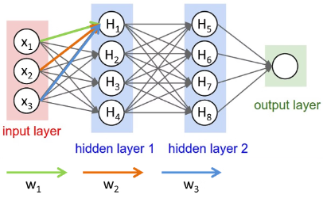
What are Convolutional Neural Networks (CNNs)?
CNNs are a type of neural network specifically designed for image processing. They leverage convolutional layers, which extract features from images through sliding filters, followed by pooling layers that reduce the spatial dimensions of the feature maps. This process helps the network recognize patterns and objects within images.
1
Feature Extraction
2
Spatial Invariance
Convolutional layers learn hierarchical features, from edges and shapes to complex patterns.
CNNs are robust to small translations or rotations in images due to their shared weights.
3
Reduced Parameters
Pooling layers decrease the number of parameters, preventing overfitting and reducing computational cost.

Slide 3
The CIFAR-10 Dataset: A Playground for Image Classification
The CIFAR-10 dataset is a popular benchmark for image classification models. It consists of 60,000 color images, divided into 10 classes (e.g., airplane, dog, cat, truck, etc.). Each image is of size 32x32 pixels, providing a balanced dataset for training and evaluating image recognition models.
Training Set
Test Set
Classes
50,000 images for training the model to recognize patterns.
10,000 images used to evaluate the model's performance on unseen data.
10 distinct classes of objects, providing a challenging and diverse benchmark.

Slide 4

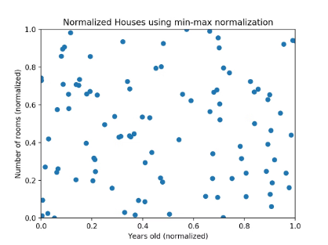
Preparing the Data: The Normalization Magic
Data normalization is a crucial step in image preprocessing. It standardizes the pixel values within a specific range, usually between 0 and 1, to improve the model's training process and prevent instability. This standardization ensures that all pixels have similar contributions to the learning process.
1
Resize
Ensure all images are the same size for consistent input to the CNN.
2
Normalize
Scale pixel values to a specific range, preventing dominance of certain features.
3
Data Augmentation
Increase dataset size by applying random transformations to existing images, enhancing model robustness.

Slide 5


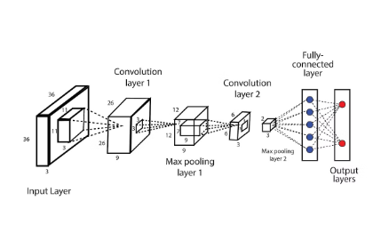


Building the CNN: Architecting for Success
A typical CNN architecture for image classification consists of multiple layers. It starts with convolutional layers that extract features, followed by pooling layers that reduce the spatial dimensions. This architecture is repeated several times, followed by fully connected layers that learn relationships between features and classify the images.
Convolutional Layers
Extract low-level features like edges and shapes.
Pooling Layers
Reduce spatial dimensions, maintaining important features.
Fully Connected Layers
Learn relationships between features and perform classification.

Slide 6

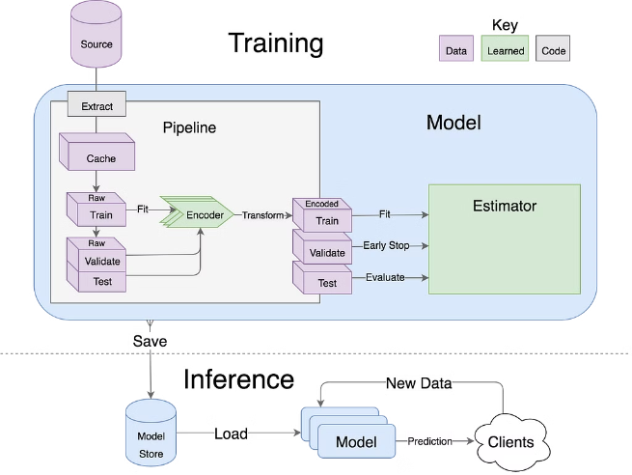
Training the Model: Fine-tuning for Accuracy
Training a CNN involves feeding the prepared image data into the model and adjusting its parameters to minimize the difference between its predictions and the true labels. This process requires a large dataset and an appropriate optimization algorithm, such as stochastic gradient descent (SGD), to guide the learning process.
Backpropagation
Optimization
Calculates the gradient of the error function with respect to the model's parameters.
Adjusts model parameters based on the calculated gradients to minimize the error.
Epochs
Iterate through the entire dataset multiple times to fine-tune the model's parameters.

Slide 7
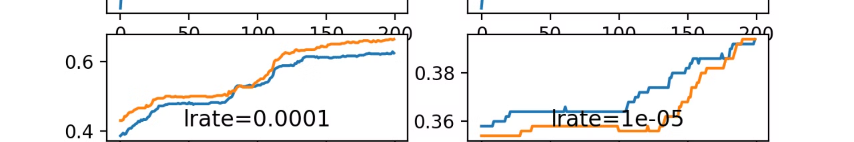
Refining the Model: Monitoring Progress and Evolution
Monitoring the model's performance during training is crucial. This involves tracking metrics like accuracy, loss, and validation accuracy. Based on these metrics, adjustments to the model architecture or training process can be made to improve its performance and prevent overfitting.
Accuracy
Percentage of correctly classified images.
Loss
Measure of the difference between predicted and actual labels.
Validation Accuracy
Evaluates the model's performance on unseen data.

Slide 8



Unveiling the Results: Prediction and Confidence
Once the model is trained, it can predict the class of a new image by processing it through the learned architecture. The output is a probability distribution over the different classes, indicating the model's confidence in its prediction. The class with the highest probability is usually considered the model's prediction.
Prediction
Confidence
Visualization
The class the model believes the image belongs to.
The probability assigned to the predicted class.
Visual representation of the model's output, showing class probabilities.

Slide 9
Conclusion:
Deep CNN image classifiers have revolutionized image recognition, achieving remarkable accuracy in identifying objects and patterns within images. Their ability to learn complex features from data and adapt to diverse scenarios makes them invaluable in various fields, empowering us to better understand and interact with the visual world.

Slide 10
Thank You

